Slide 1

TAYSAN SENIOR HIGH SCHOOL
HISTORY

Slide 2
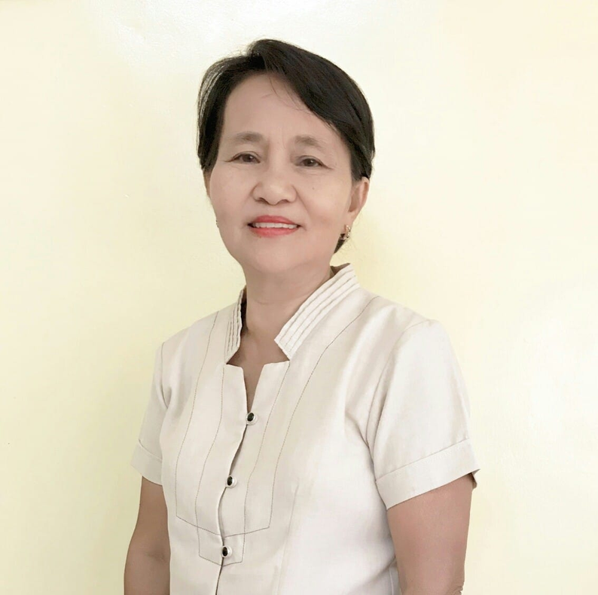
TAYSAN SENIOR HIGH SCHOOL
PRINCIPAL
MRS. EVA B. CAMILAN
JUNE 2016- JANUARY 2017

Slide 3
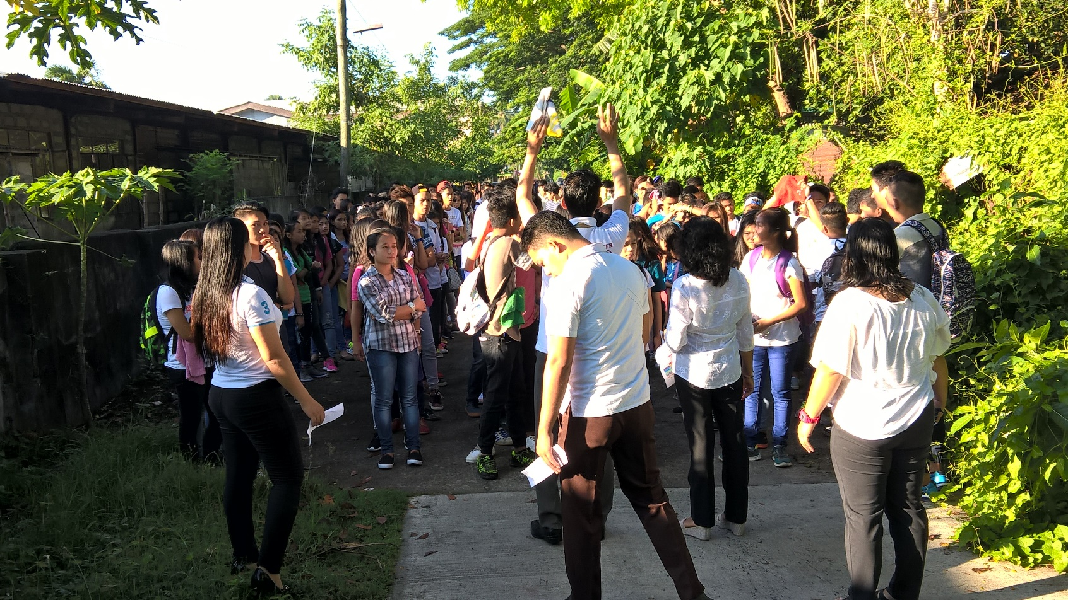
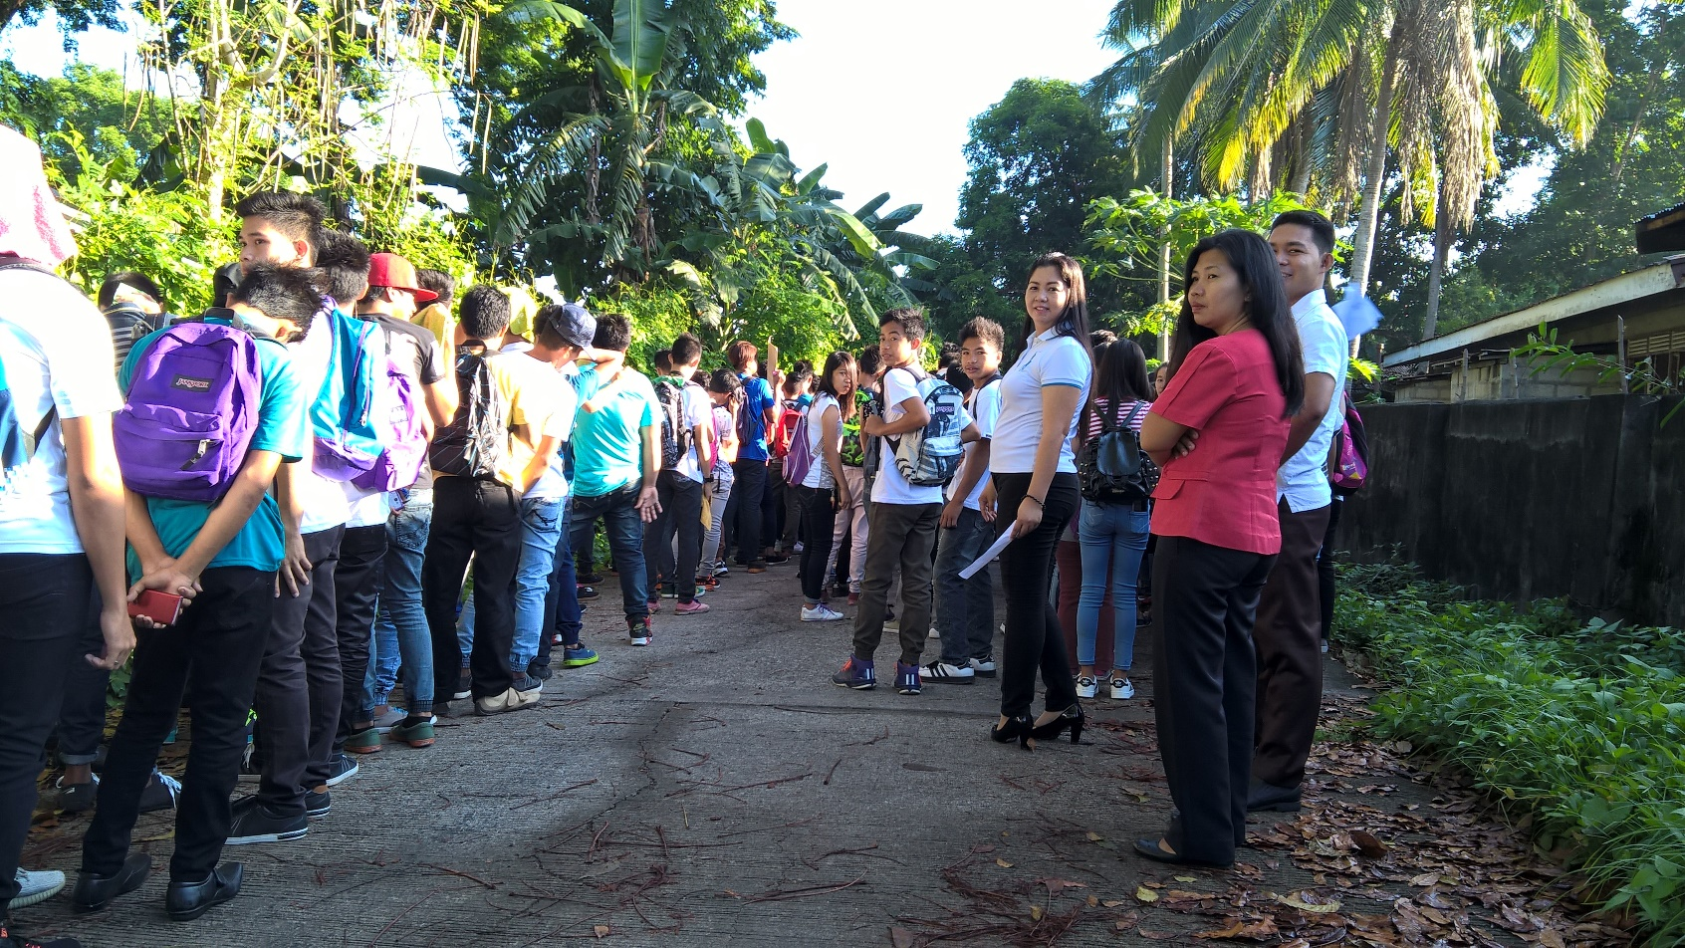
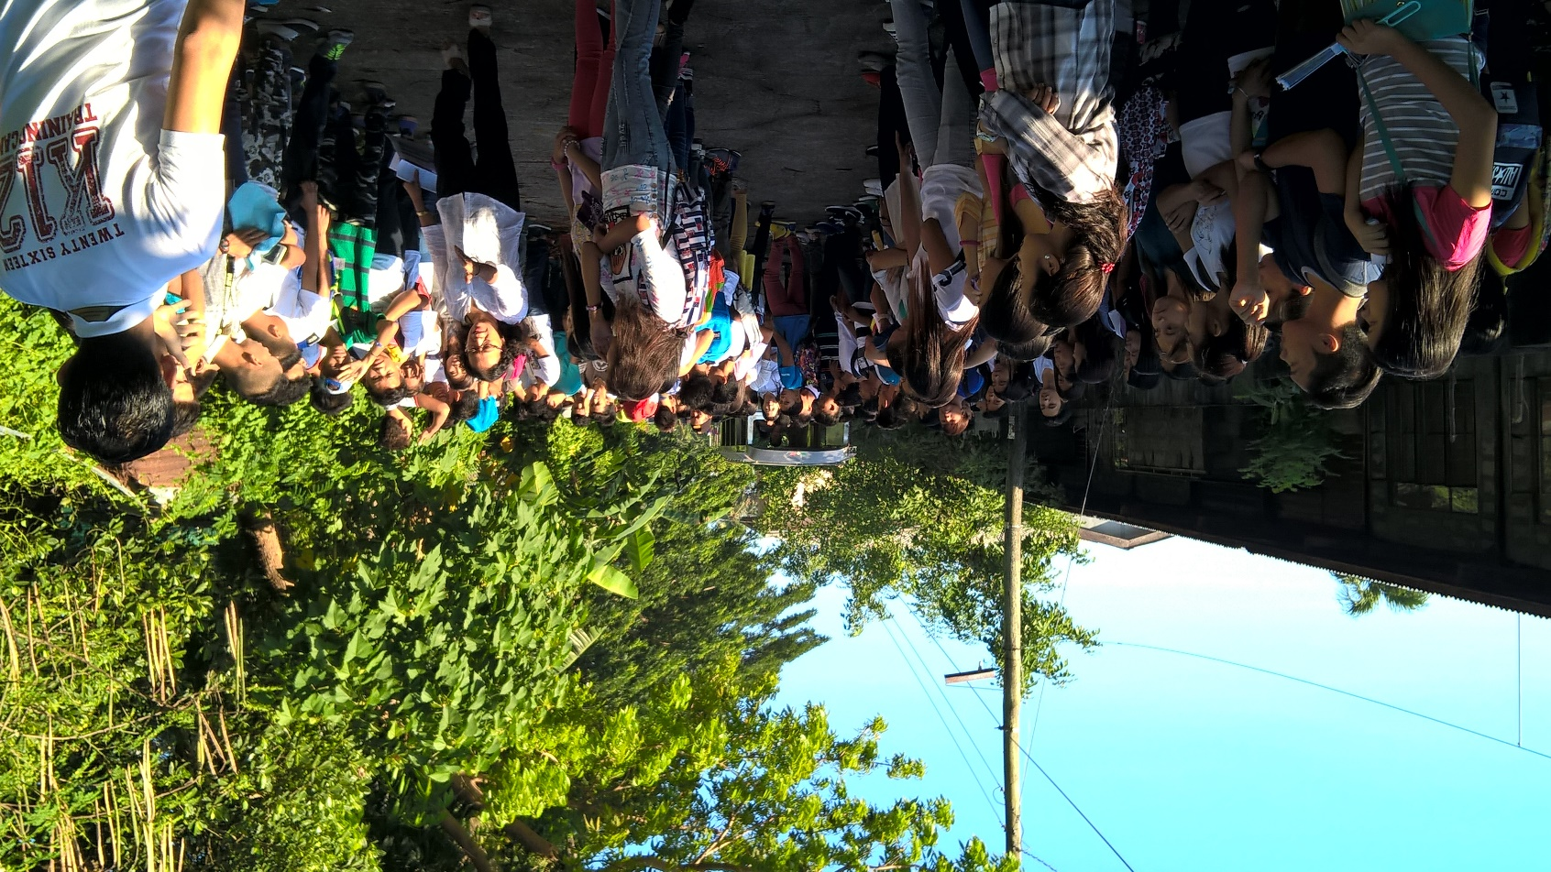
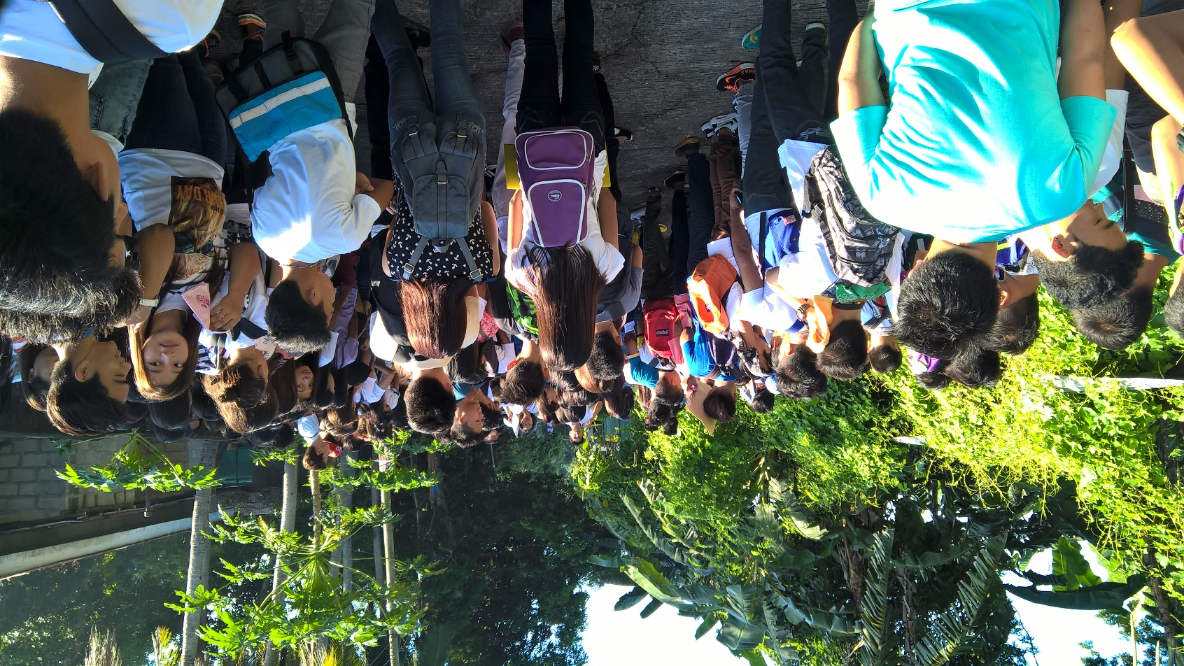
JUNE 13, 2016
Notes:
OPENING OF CLASSES

Slide 4
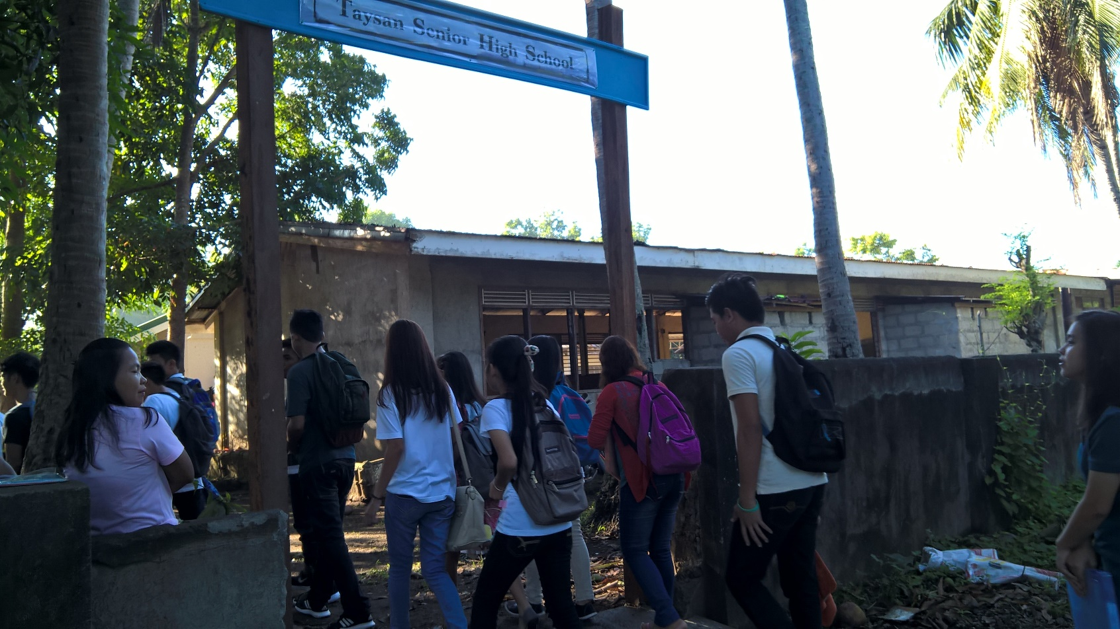
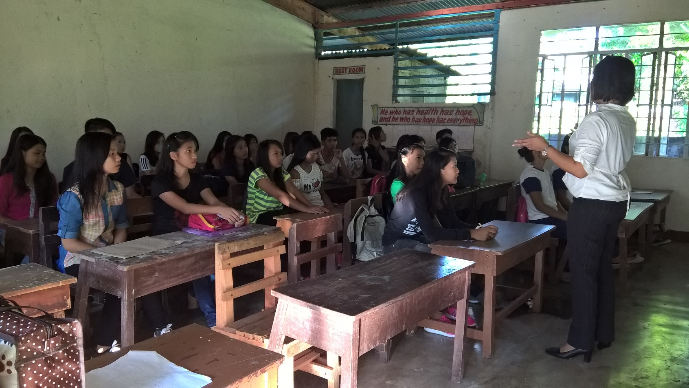
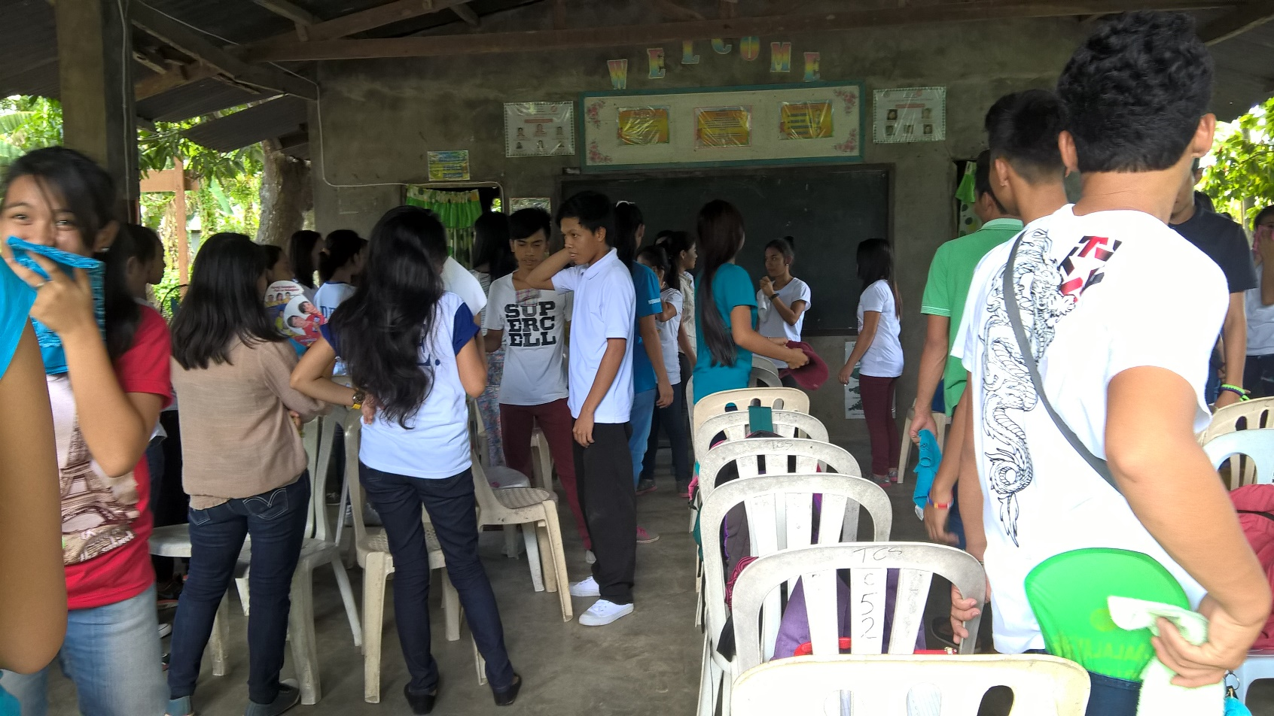
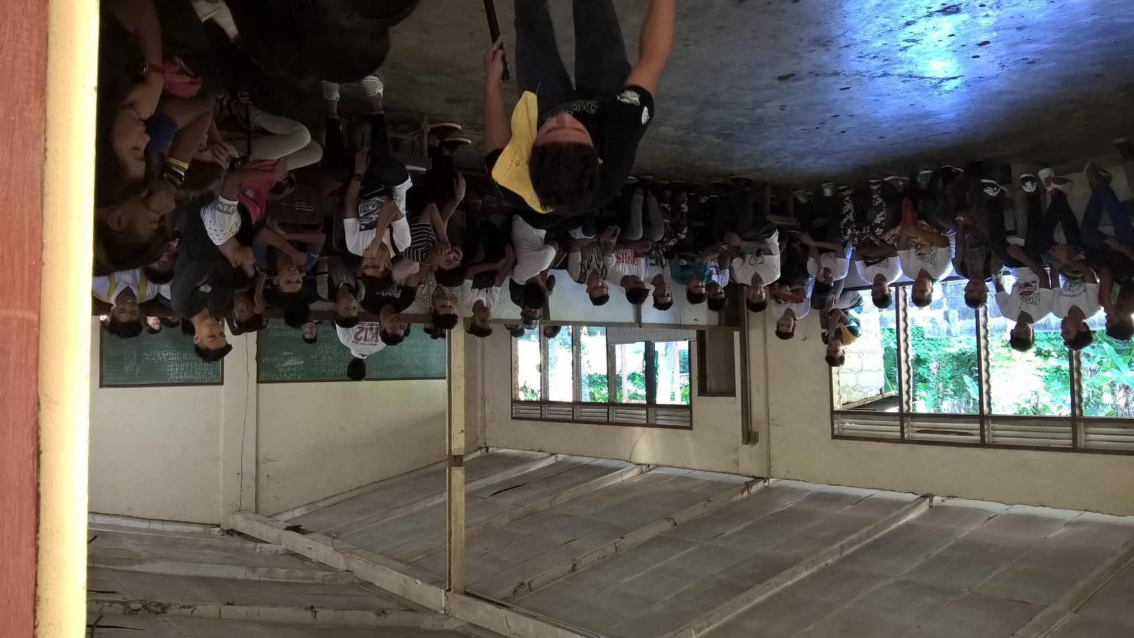
Notes:
CLASSES AT TAYSAN CENTRAL SCHOOL

Slide 5

… OFFERED STRANDS
Notes:
OPENING OF CLASSES

Slide 6
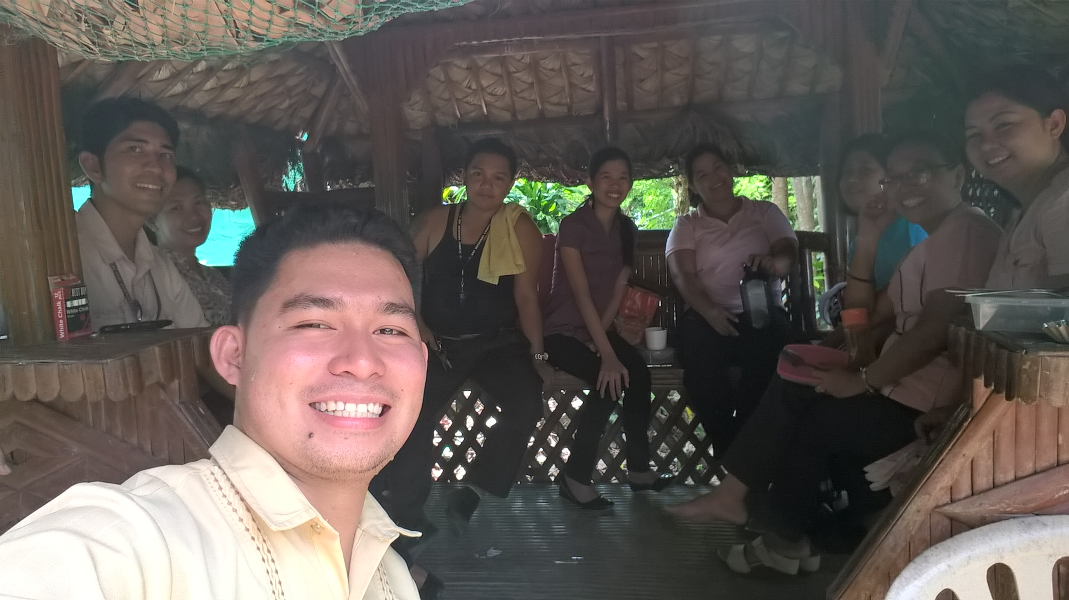
… STARTED WITH 9 TEACHERS
… WHO WERE TRAINED DURING THE “MASS TRAINING OF TEACHERS” FROM MAY 23 – JUNE 12, 2023
Notes:
OPENING OF CLASSES

Slide 7
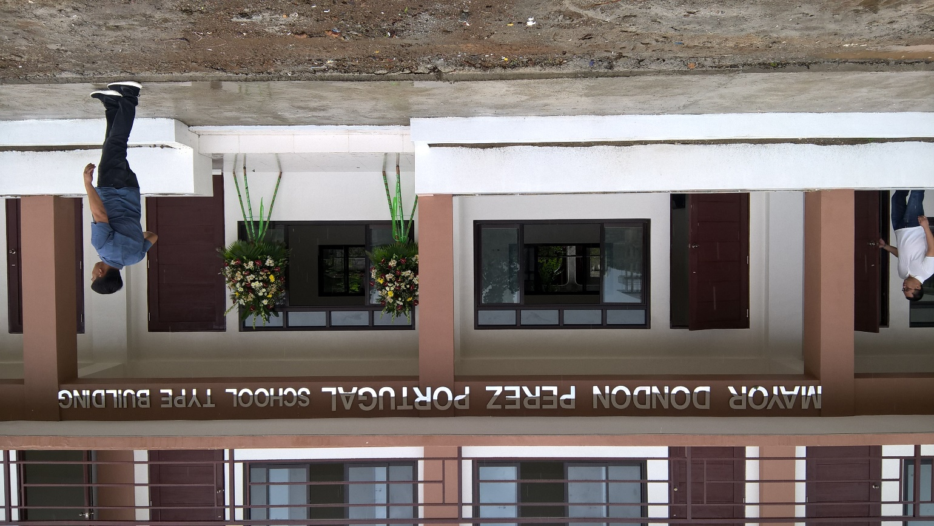
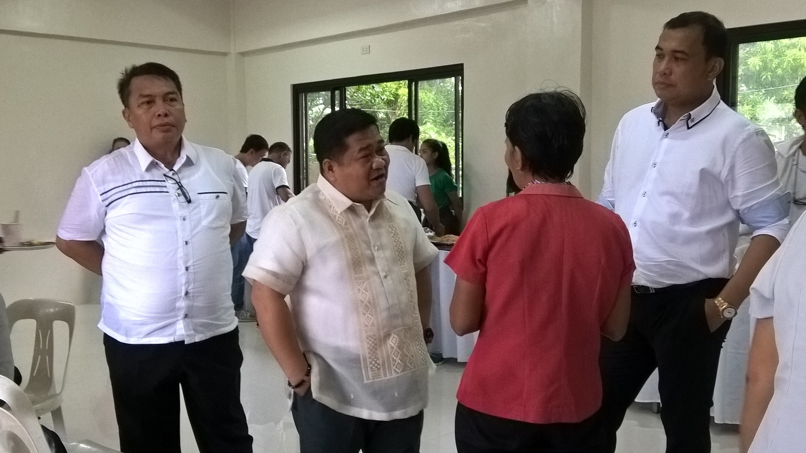
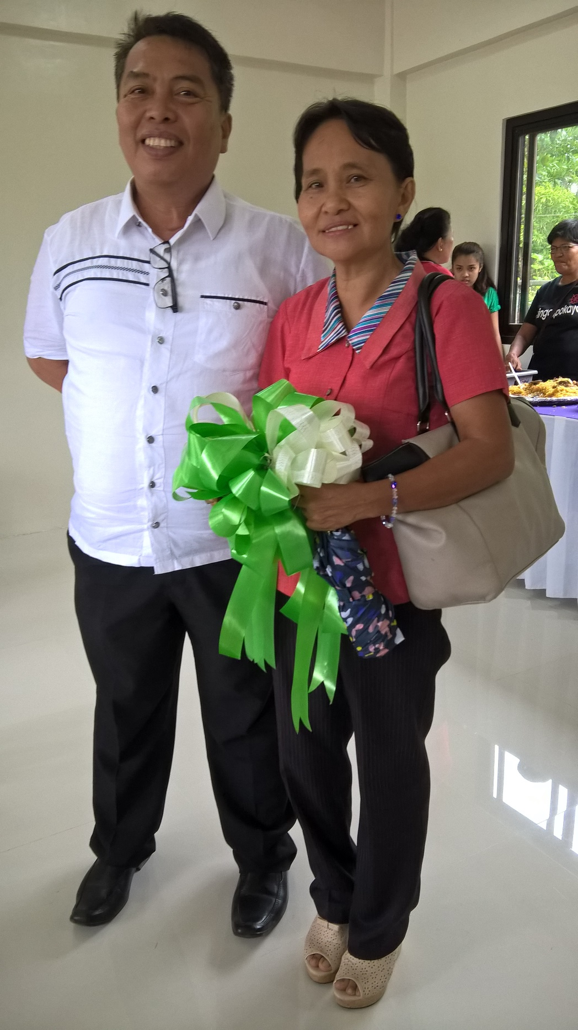
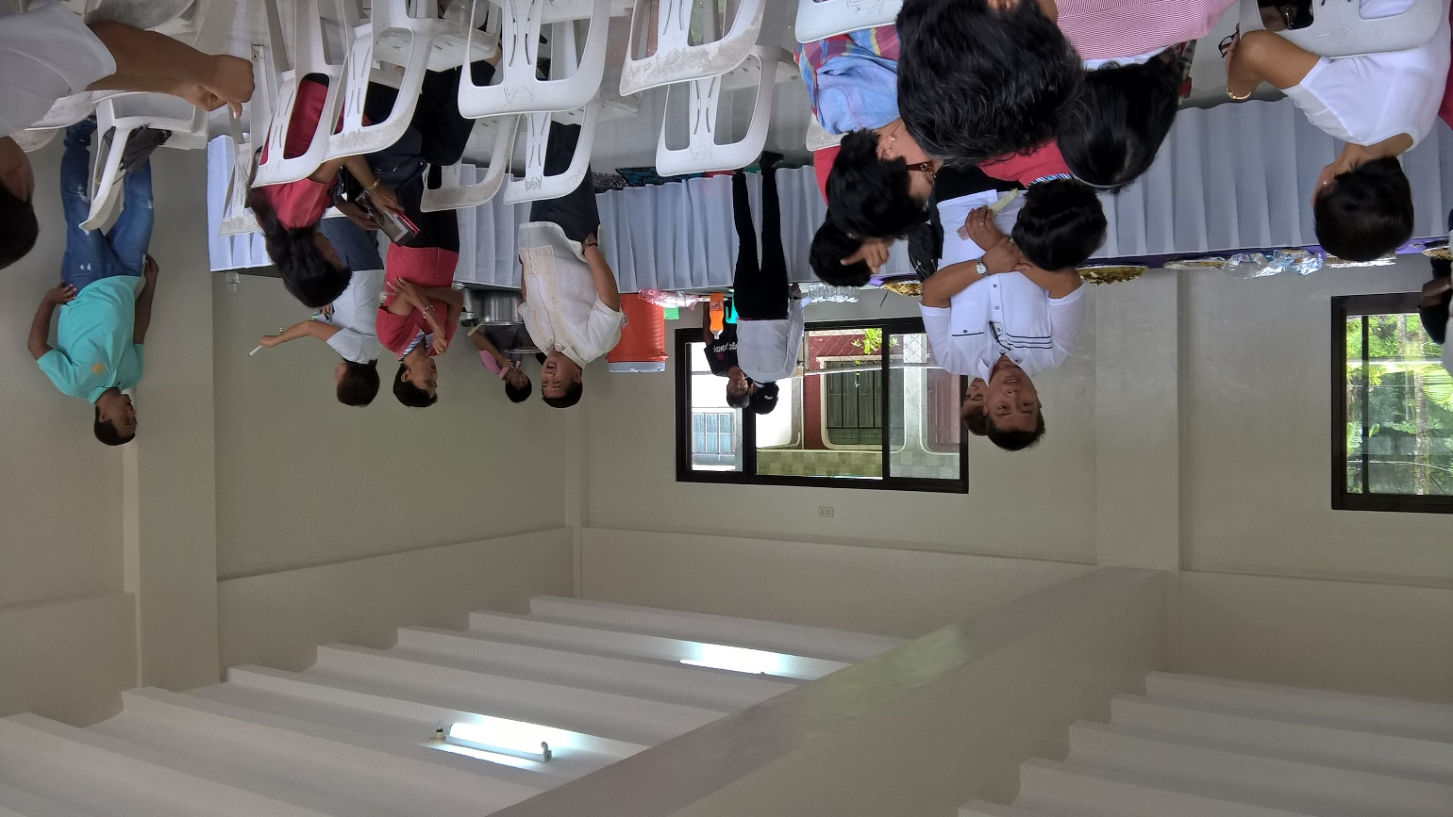
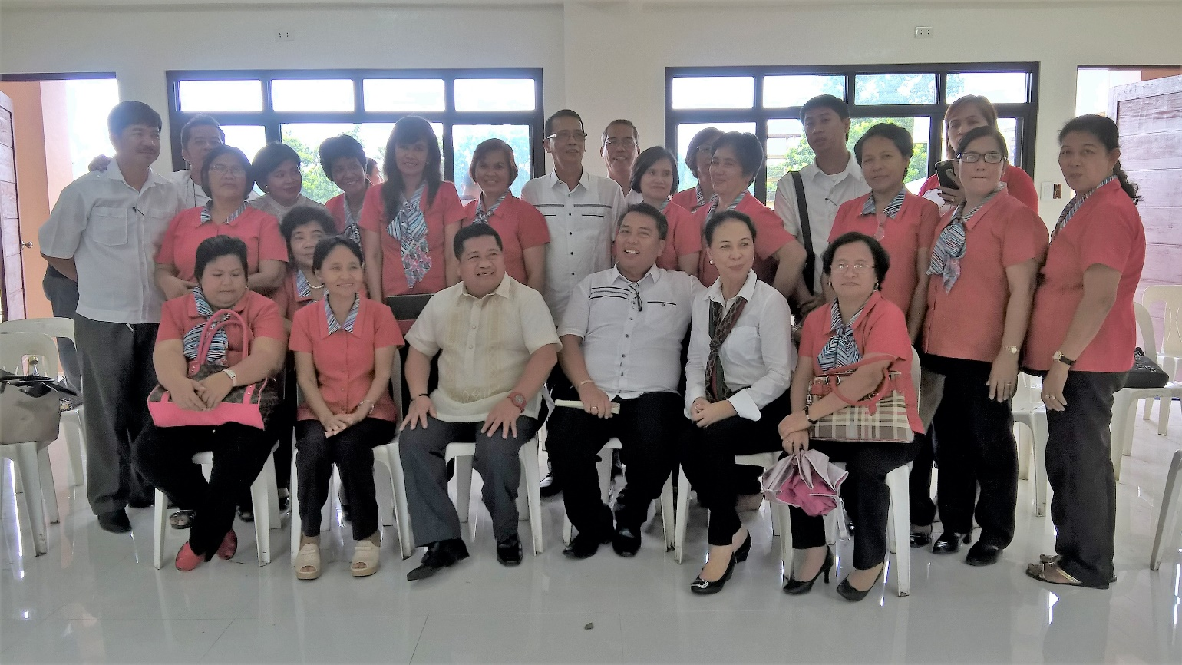
Turn over Ceremony held on June 27, 2016

Slide 8
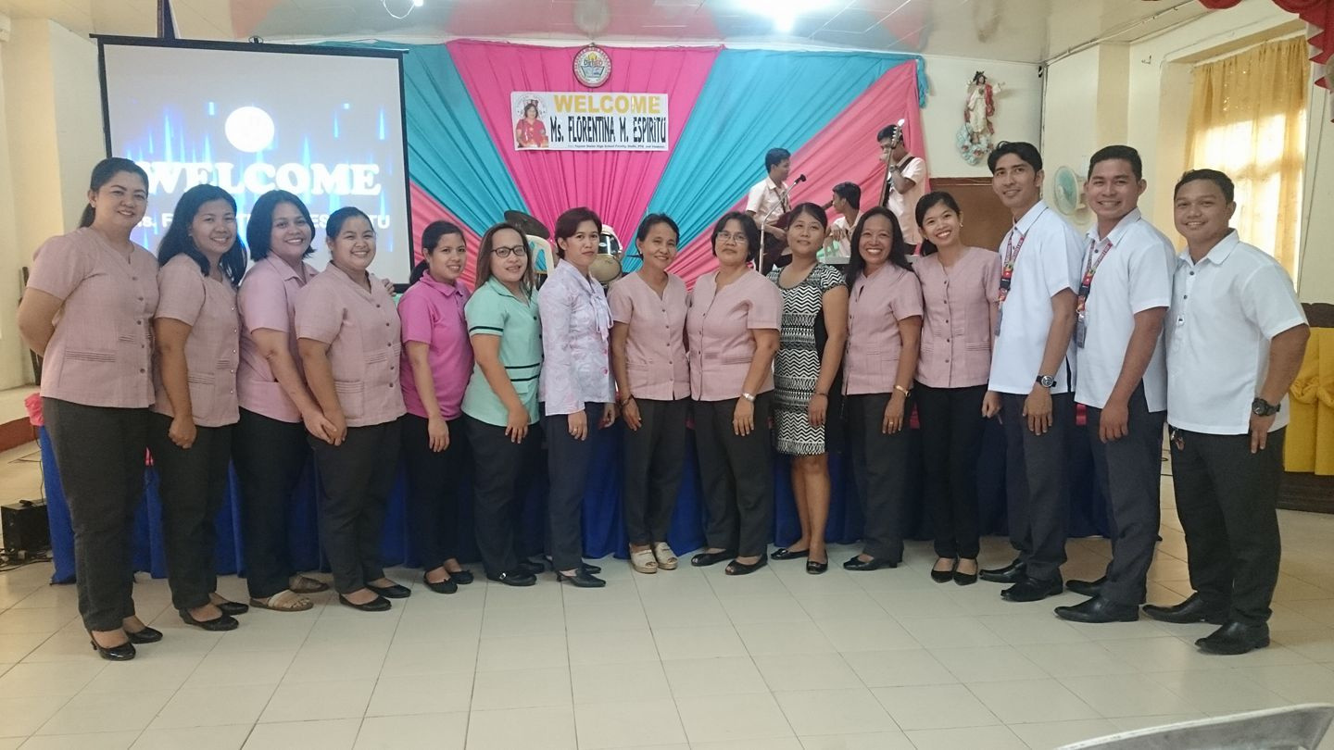


Slide 9
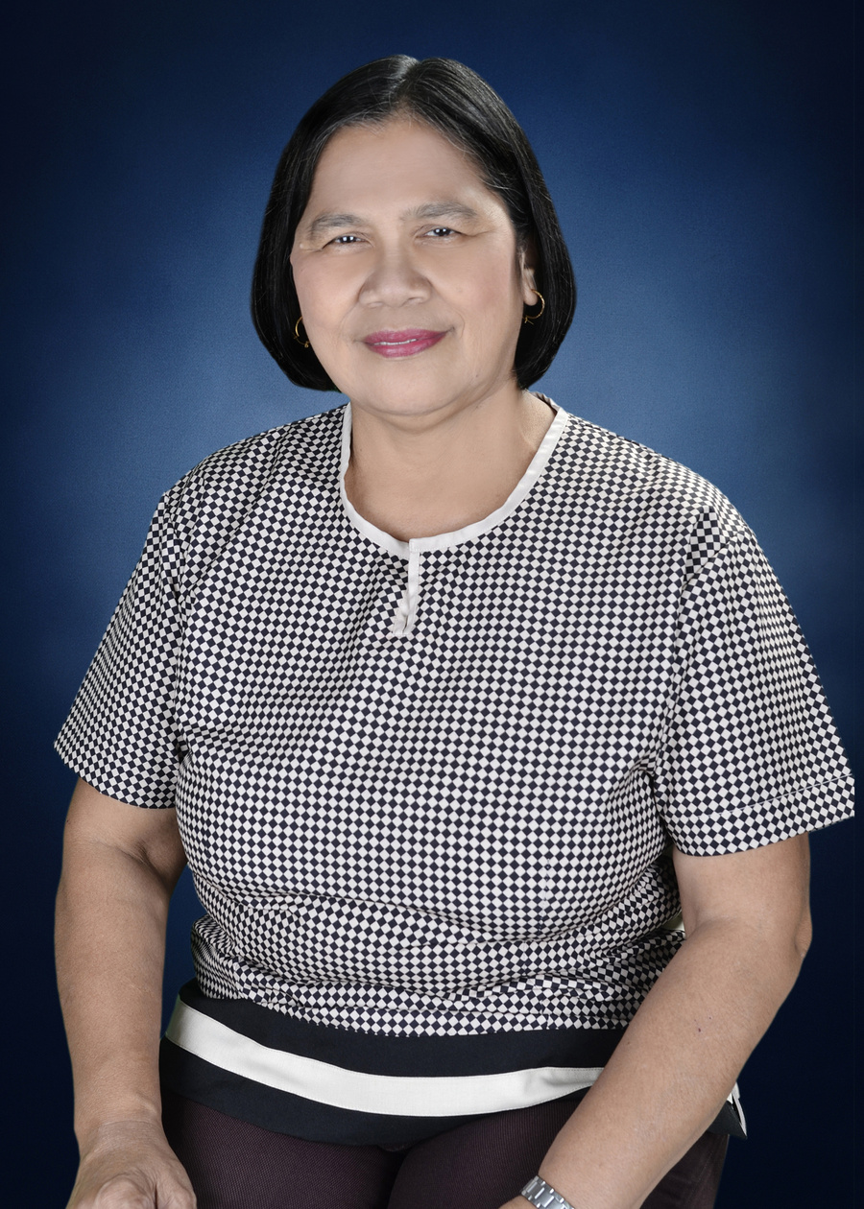
TAYSAN SENIOR HIGH SCHOOL
PRINCIPAL
MS. FLORENTINA M. ESPIRITU
JANUARY 2017 - DECEMBER 2022

Slide 10
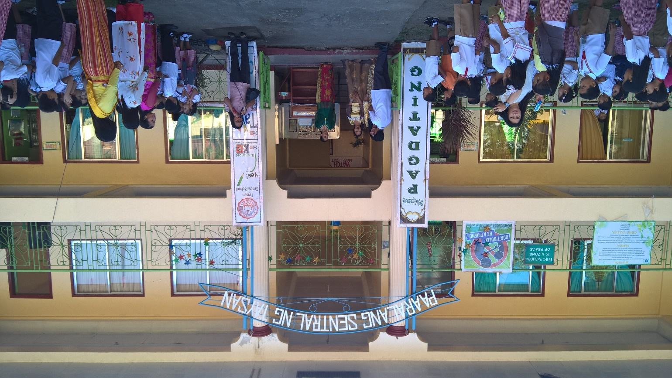
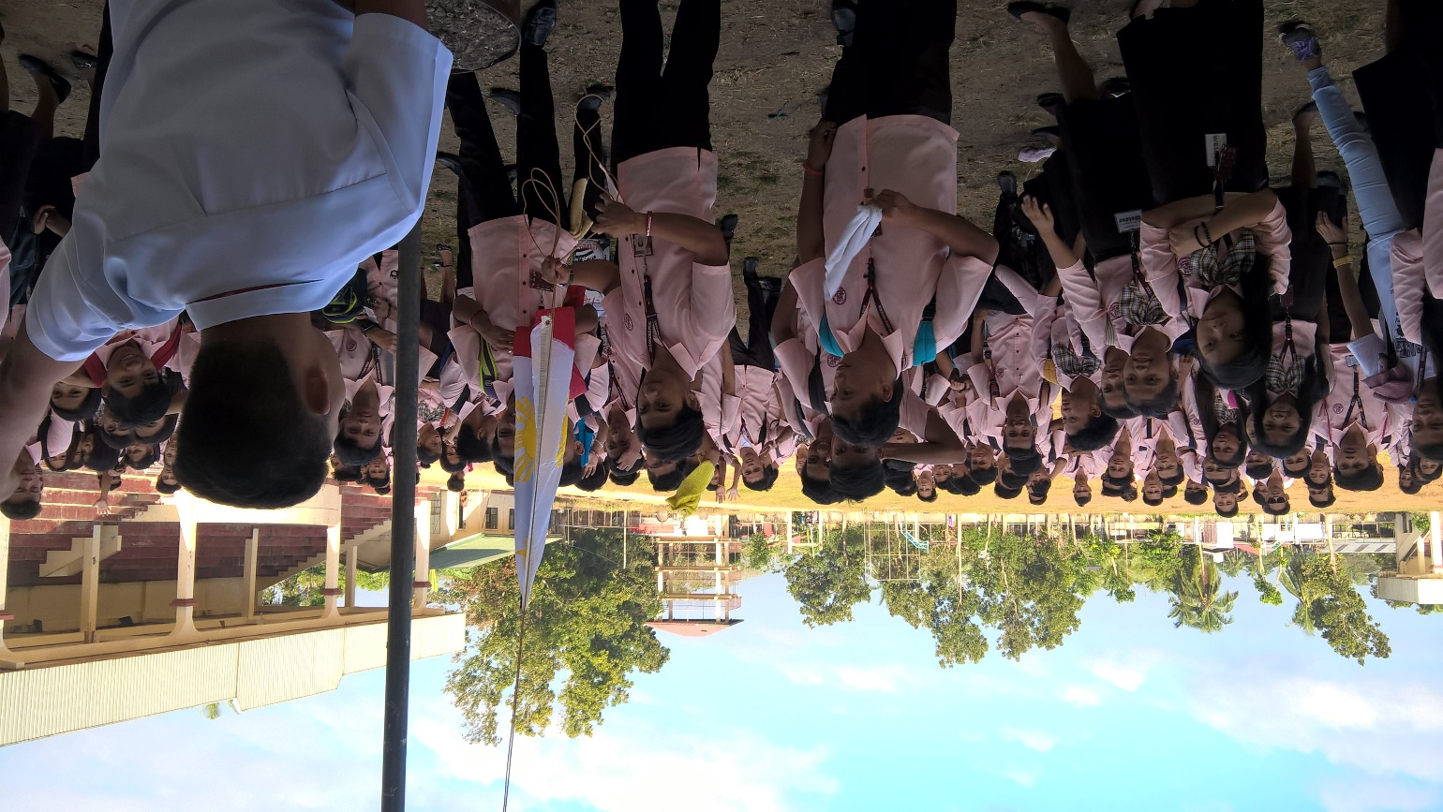
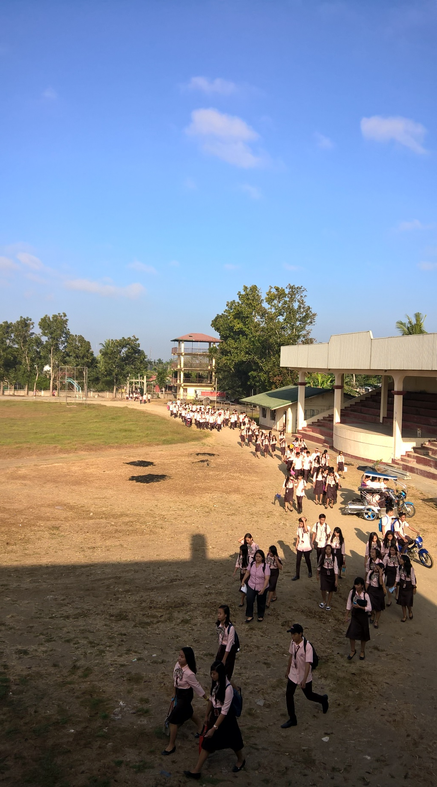
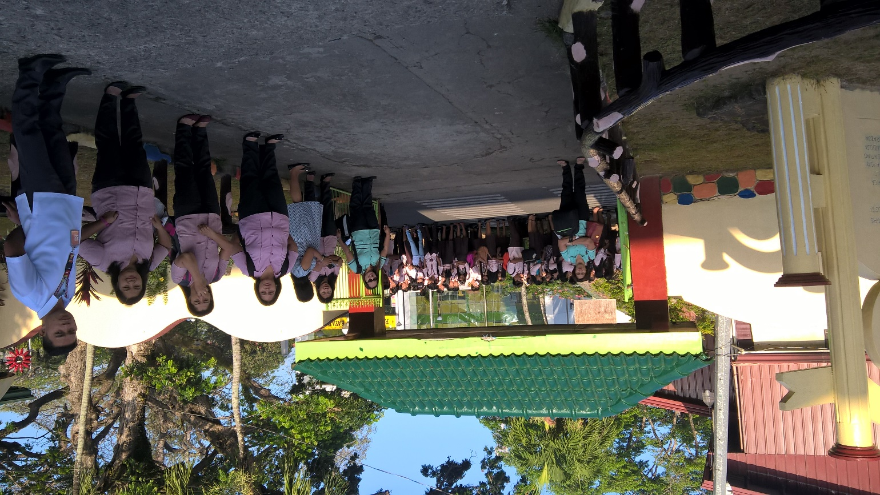
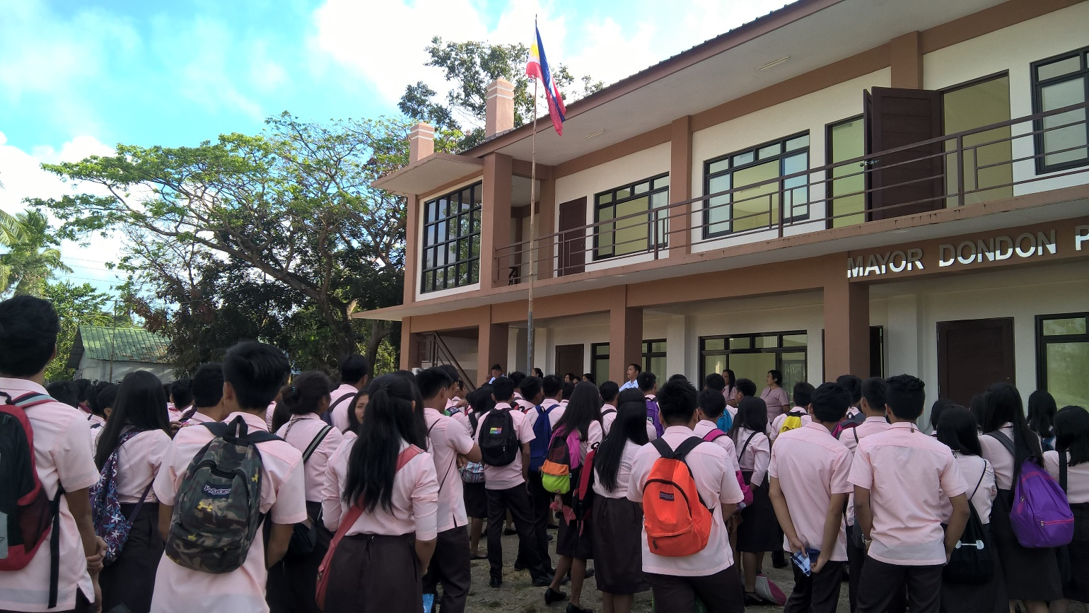
… transferred from Taysan CS to Taysan SHS
Notes:
OPENING OF CLASSES

Slide 11
STRANDS OFFERED
1
ACADEMIC TRACK
2
TECHNICAL-VOCATIONAL-LIVELIHOOD
Accountancy, Business, & Management (ABM) Strand
Humanities & Social Sciences (HUMSS) Strand
Science, Technology, Engineering, & Mathematics (STEM) Strand
Home Economics (HE) Strand specialization in Housekeeping NCII, Wellness Massage NCII, Events Management Services NCIII
Industrial Arts (IA) Strand specialization in Shielded Metal Arc Welding (SMAW) NCI & NCII and Automotive Servicing NCI

Slide 12

TEACHING AND NON-TEACHING PERSONNEL

Slide 13
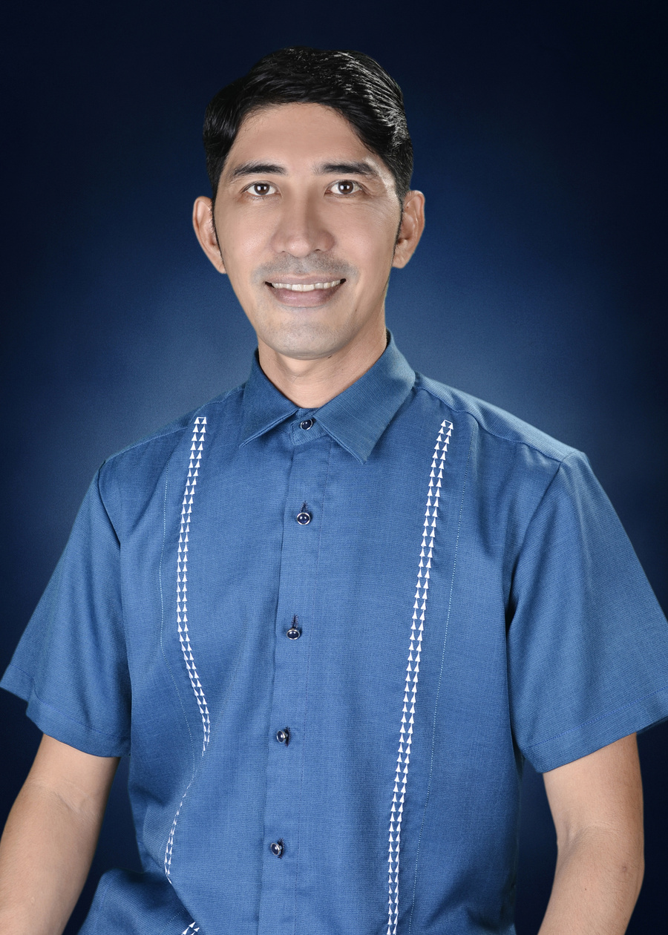
TAYSAN SENIOR HIGH SCHOOL
TEACHER-IN-CHARGE
MR. ROD R. MAGALONA
JANUARY 2023 – TO PRESENT

Slide 14




TAYSAN SENIOR HIGH SCHOOL
INFORMATION
SCHOOL ID: 342221
https://www.facebook.com/DepEdTayoTSHS342221
taysanseniorhighschool@yahoo.com or 342221@deped.gov.ph
(043) 786 6254
Mahanadiong, Taysan, Batangas

Slide 15
For other events in the previous years of the school, you may visit the school FB Page.
https://www.facebook.com/DepEdTayoTSHS342221

